Slide 1
Python-based spatial multi-omics analysis
11/16/2023
Mingze Dong
Notes:
Hello everyone, my name is Mingze Dong. Today I am here to present the paper named:

Slide 2
Outline
Usage of Scanpy and Squidpy
Analysis of P22 mouse brain dataset in (Di, 2023)
Introduction to scvi-tools (If time permits)

Slide 3
Outline
Usage of Scanpy and Squidpy
Analysis of P22 mouse brain dataset in (Di, 2023)
Introduction to scvi-tools (If time permits)

Slide 4
Introduction to Scanpy
A Python toolbox that is used to analyze scRNA-seq data, similar to Seurat in R
Advantages: Clear dataset structure; easier interaction with advanced machine learning methods; Central in the scverse ecosystem
Disadvantages: Functions not exactly compatible with Seurat, can be painful for Python beginners / to switch between Python and R environments, poor support for ATAC-seq data

Slide 5
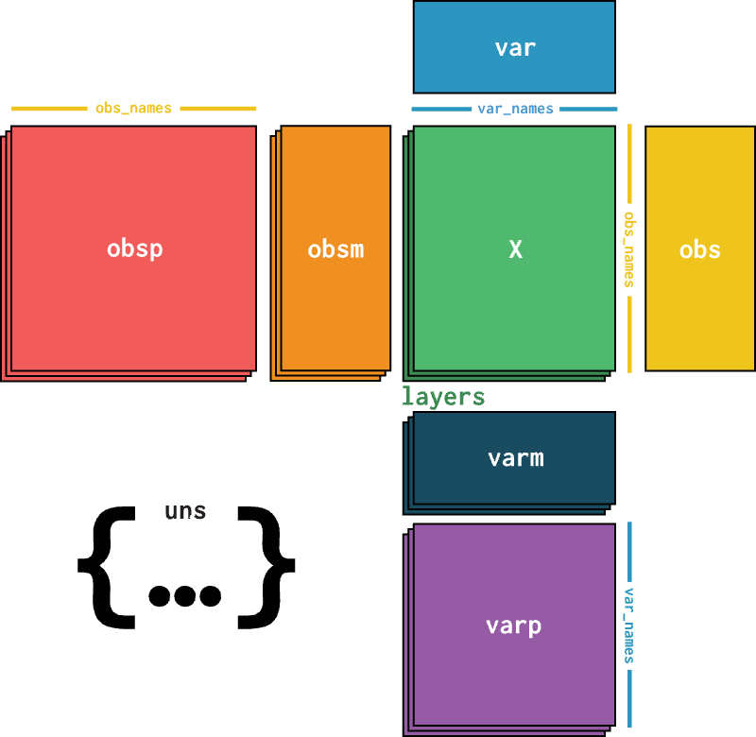
Scanpy data structure: AnnData
X: data matrix (cell by gene)
Obs: cell metadata (library size, cell type…)
Obsm: (Multi-dimensional) cell embeddings
Var: gene metadata (mean, dispersion, is highly variable…)
Uns: Settings

Slide 6
Scanpy data structure: AnnData
Q & A:
Where would be principal components of a cell?
Where would be the dataset’s pixel size?
Where would be the cell’s spatial location?

Slide 7
Scanpy analysis pipeline
Although Scanpy is developed for scRNA-seq data, it can be directly adopted for spatial omics data analysis.
Preprocessing: sc.pp
Common pipeline: normalize_total, log1p, highly_variable_genes, pca, neighbors
Visualization: sc.tl, sc.pl
tSNE, UMAP…

Slide 8
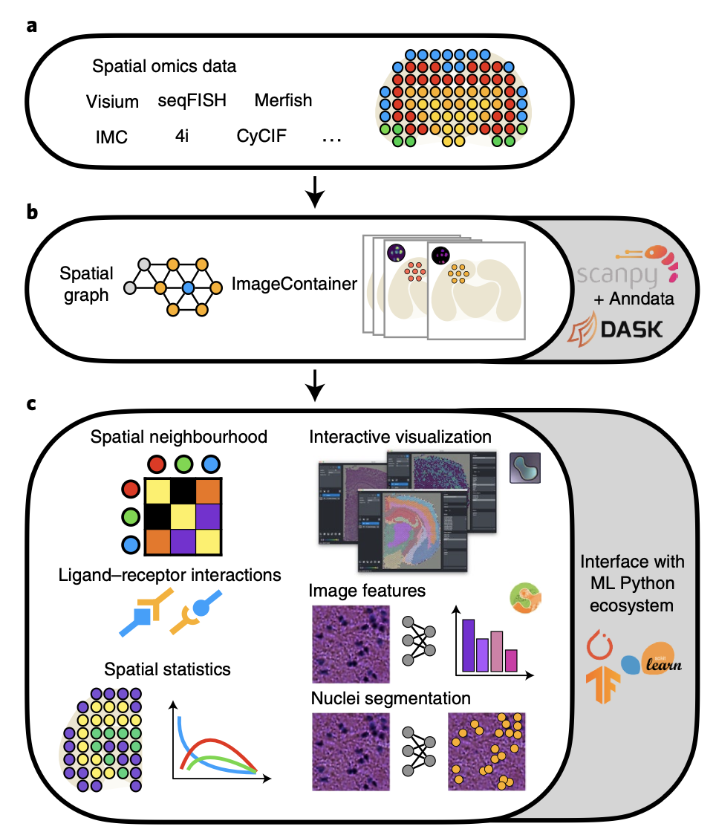
Introduction to Squidpy
A Python toolbox based on Scanpy that provides additional spatial analysis methods
Inherits the data structure from Scanpy, but provides more flexibility on image processing, analysis and plotting
Palla, Giovanni, et al. Nature methods 19.2 (2022): 171-178.

Slide 9
Introduction to Squidpy
Palla, Giovanni, et al. Nature methods 19.2 (2022): 171-178.

Slide 10
Coding: Using Scanpy and Squidpy to analyze the P22 mouse brain dataset in (Di, 2023)

Slide 11
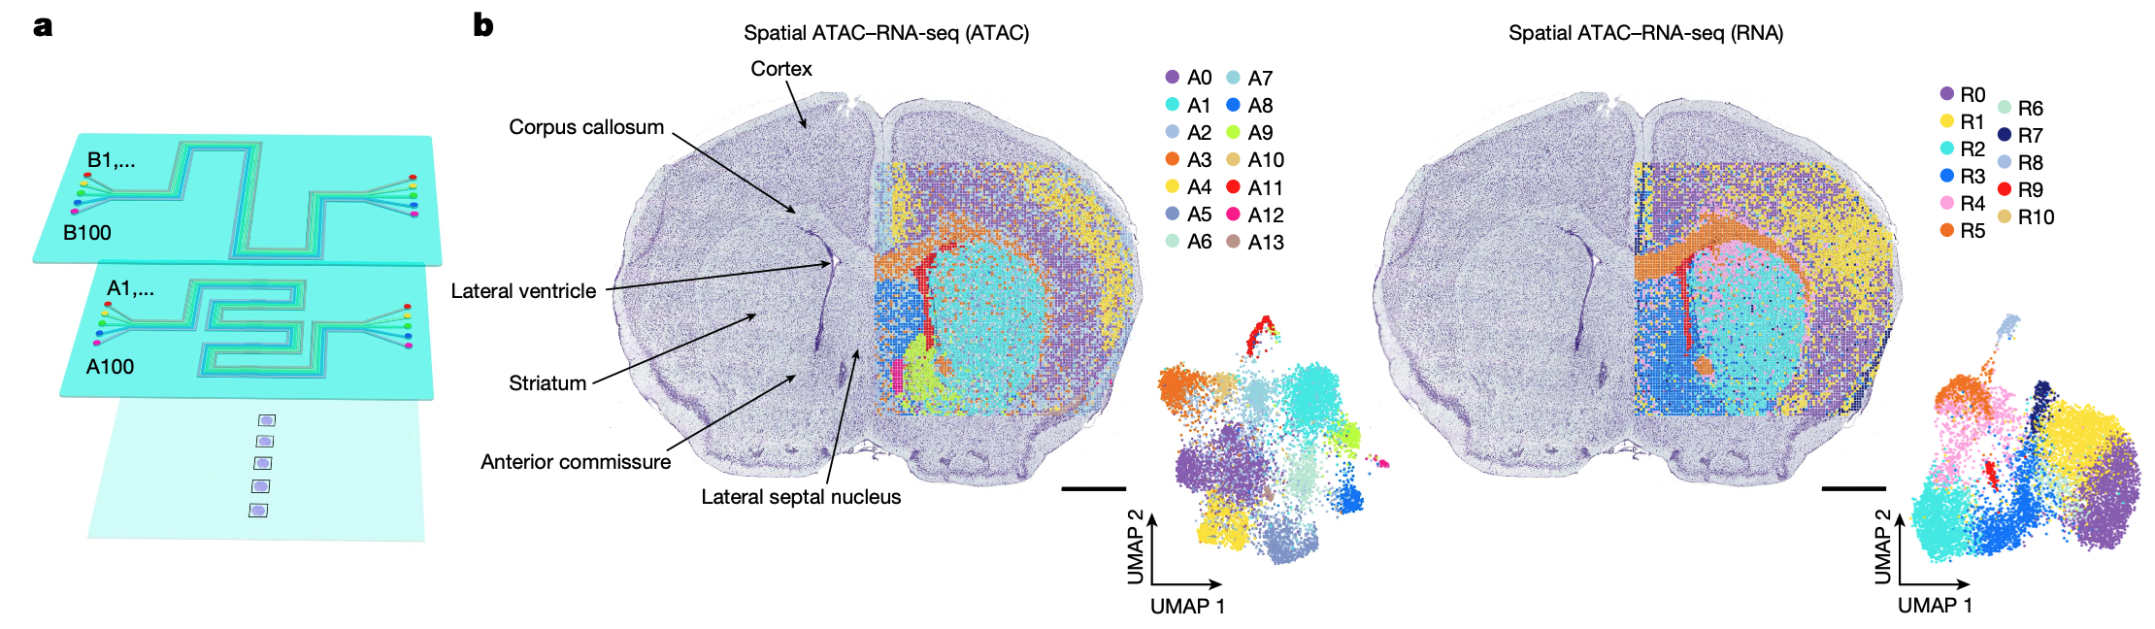
The Spatial-RNA-ATAC-seq dataset

Slide 12
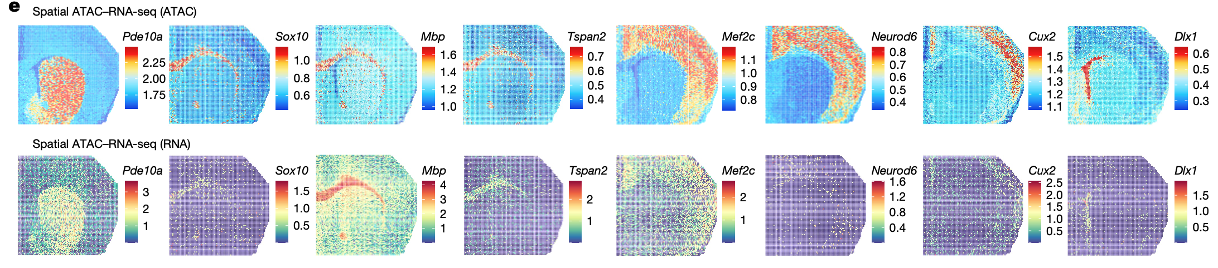
The Spatial-RNA-ATAC-seq dataset

Slide 13
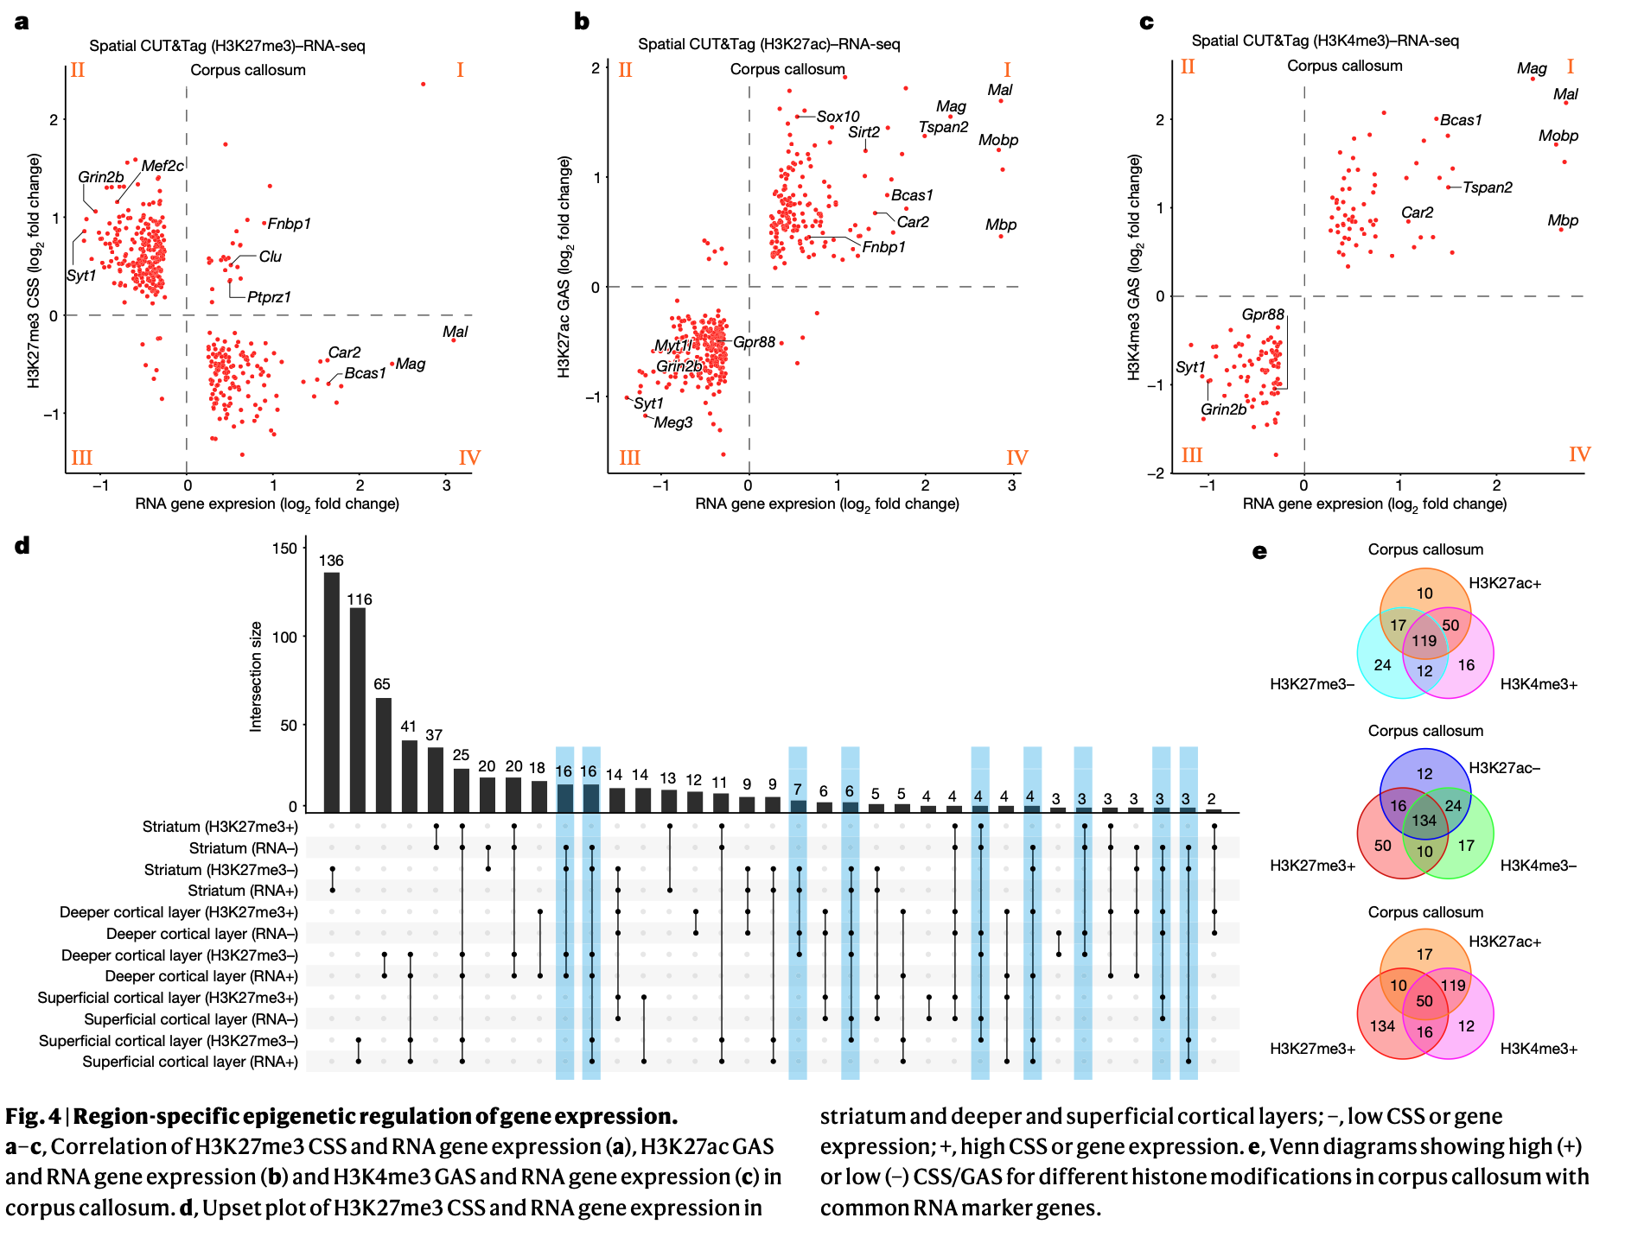
Region-specific epigenetic regulation

Slide 14
Outline
Usage of Scanpy and Squidpy
Analysis of P22 mouse brain dataset in (Di, 2023)
Introduction to scvi-tools (If time permits)

Slide 15
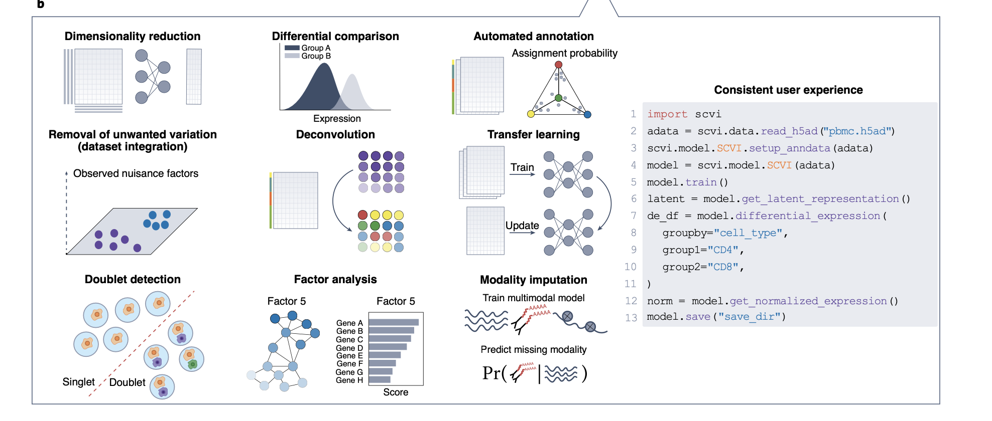
Introduction to scvi-tools
A powerful tool for probabilistic modeling of omics datasets
Gayoso, Adam, et al. Nature biotechnology 40.2 (2022): 163-166.

Slide 16
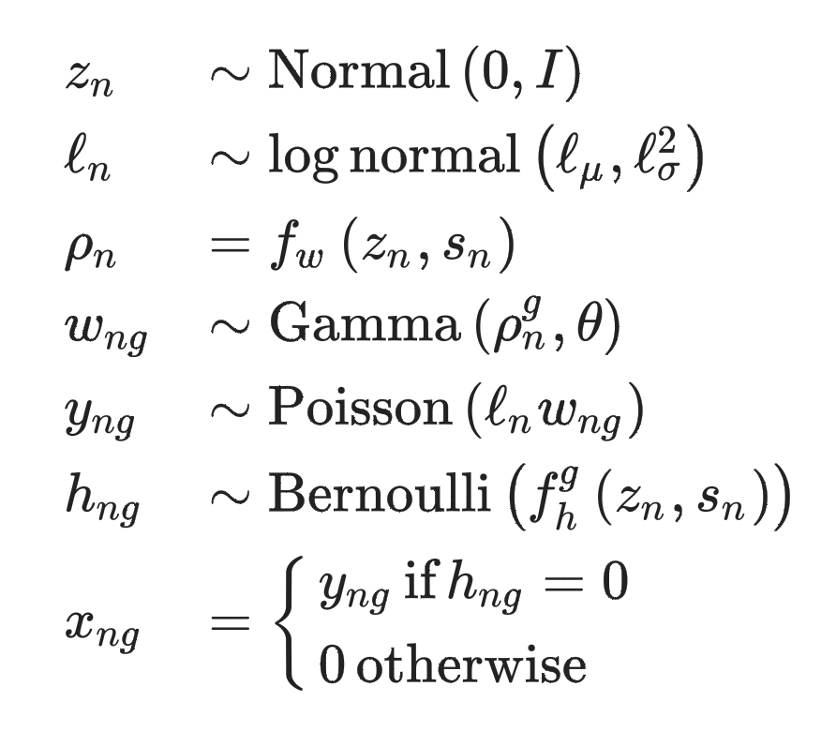
Introduction to scvi-tools
Various variational inference (VI) procedures are developed based on engineering the scVI generative process:

Slide 17
Introduction to scvi-tools
Batch integration: scVI, scANVI, …
Perturbation modeling: ContrastiveVI
Multi-omics: MultiVI, TotalVI
Spatial data deconvolution: GIMVI, DestVI
Spatial effect modeling: SIMVI

Slide 18
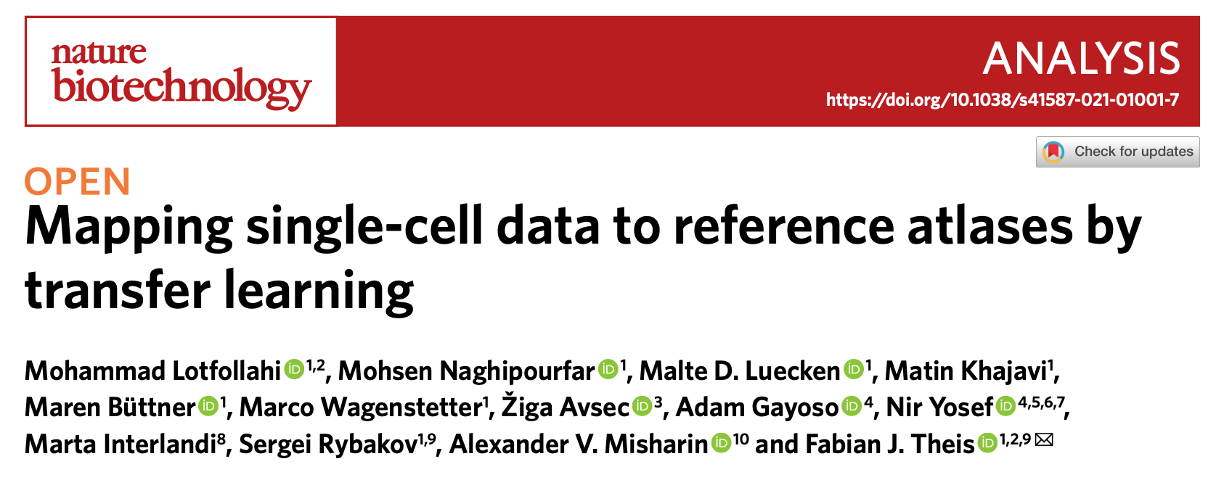
Introduction to scArches

Slide 19
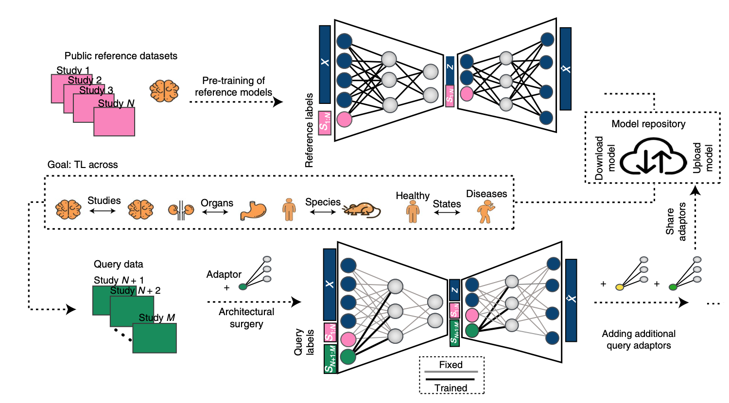
Introduction to scArches

Slide 20
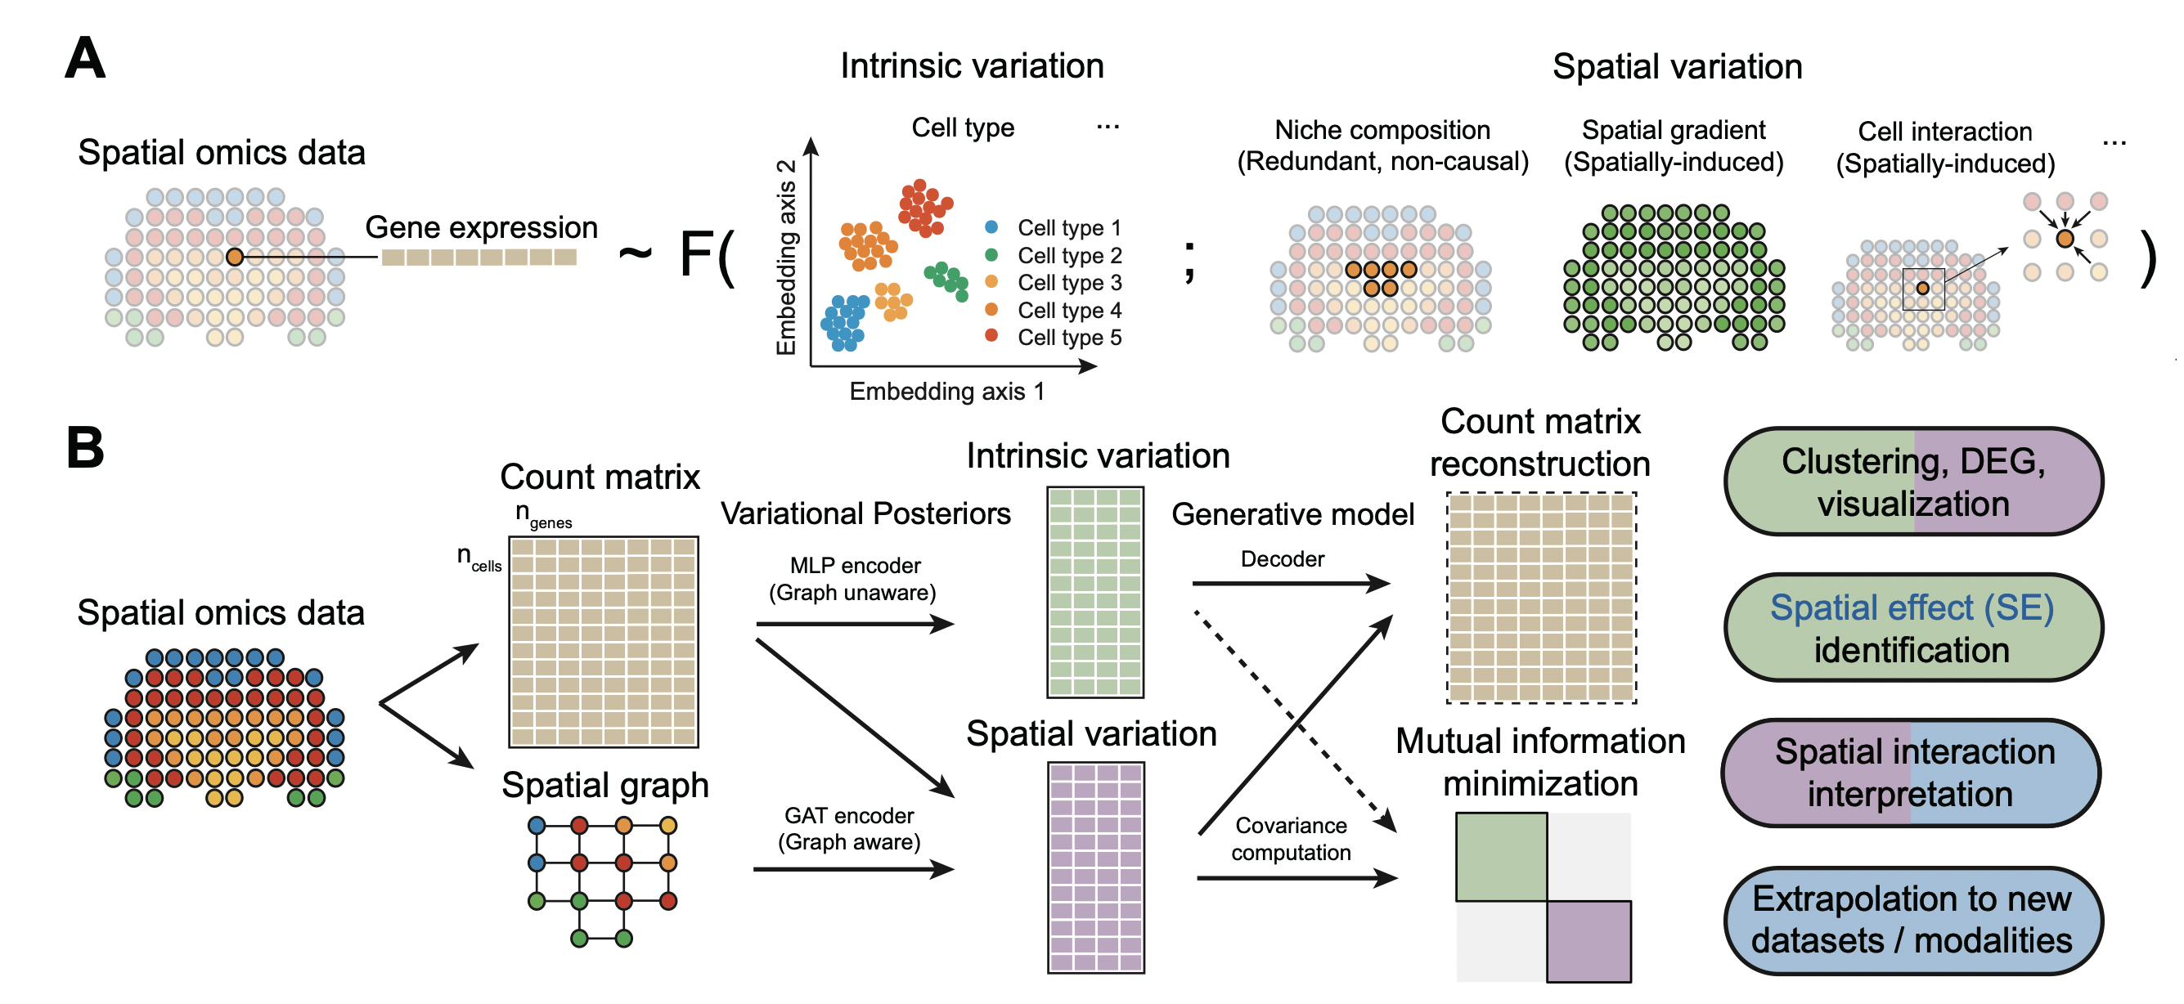
Introduction to SIMVI

Slide 21
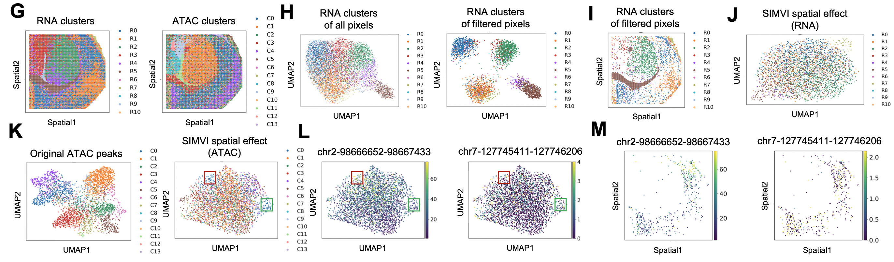
Using SIMVI to understand the spatial effects

